Slide 1
Online Retail Segmentation
Customer Segmentation Analysis Using SQL

Slide 2
Introduction
Objectives:
Understand customer segmentation in online retail.
Analyze purchasing patterns and customer behavior.
Use SQL to extract business insights from the dataset.
Dataset Overview:
Dataset includes customer data, such as:
InvoiceNo, StockCode, Description, Quantity, InvoiceDate, UnitPrice, CustomerID, Country.

Slide 3
SQL Queries Overview
Purpose of Queries:
Extract business insights from data using SQL.
Identify purchase behaviors, order values, customer churn, and more.
Key Queries Used:
Order value distribution across customers.
Unique products purchased by each customer.
Single-purchase customers.
Most commonly purchased product bundles.
Customer segmentation by purchase frequency.
Customer churn analysis.

Slide 4
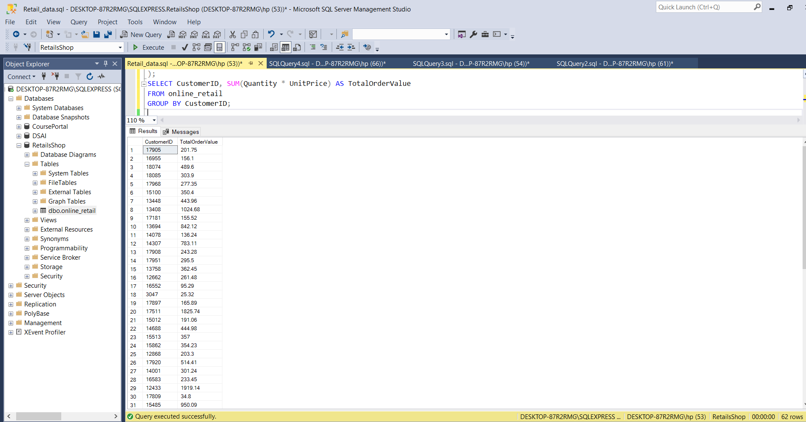
Order Value Distribution
Query Purpose:
Identify total spending by each customer.
Key Findings:
Majority of revenue comes from a small number of high-value customers.

Slide 5
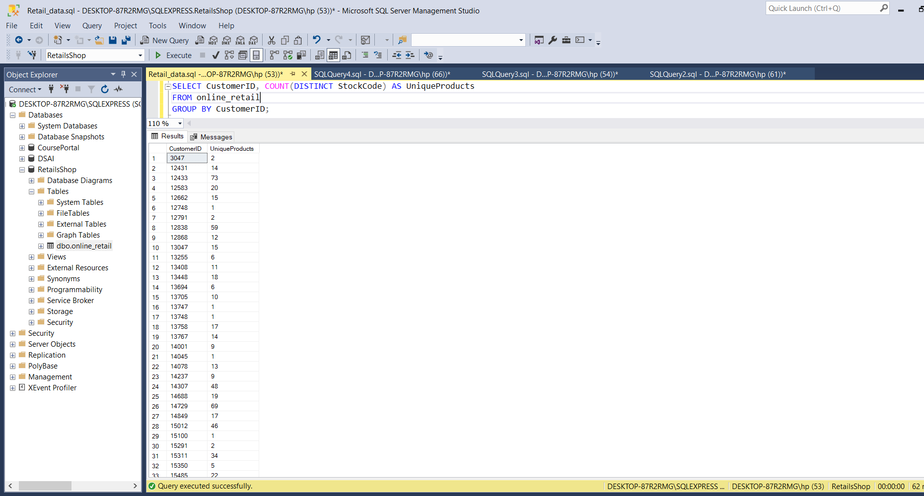
Unique Products Purchased
Query Purpose: Analyze diversity of products purchased by each customer.
Key Findings: Most customers buy a small number of unique products. Some customers have diverse purchasing patterns.

Slide 6
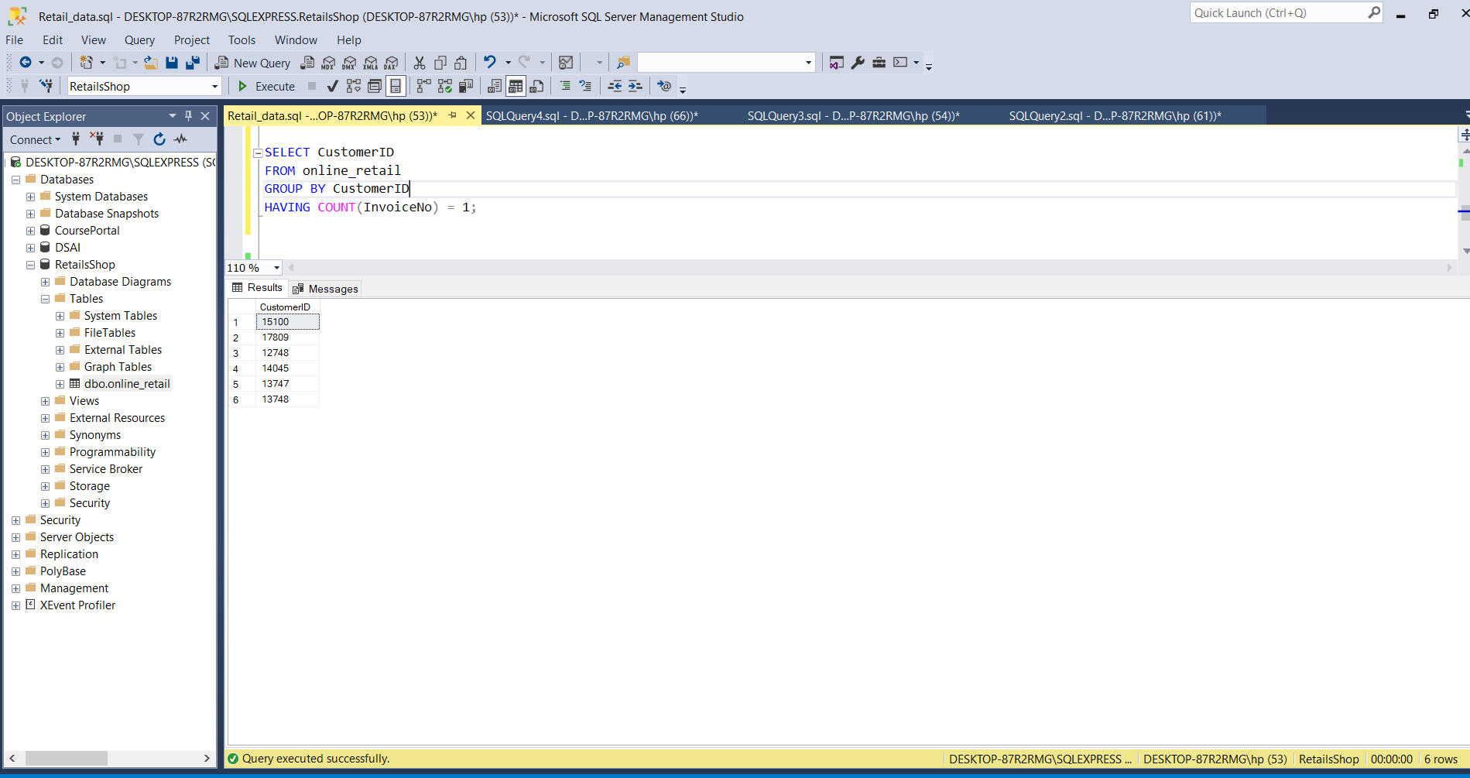
Single-Purchase Customers
Query Purpose:
Identify customers who have only made one purchase.
Key Findings:
A significant portion of customers are
single-purchase customers, providing
an opportunity for re-engagement campaigns.

Slide 7
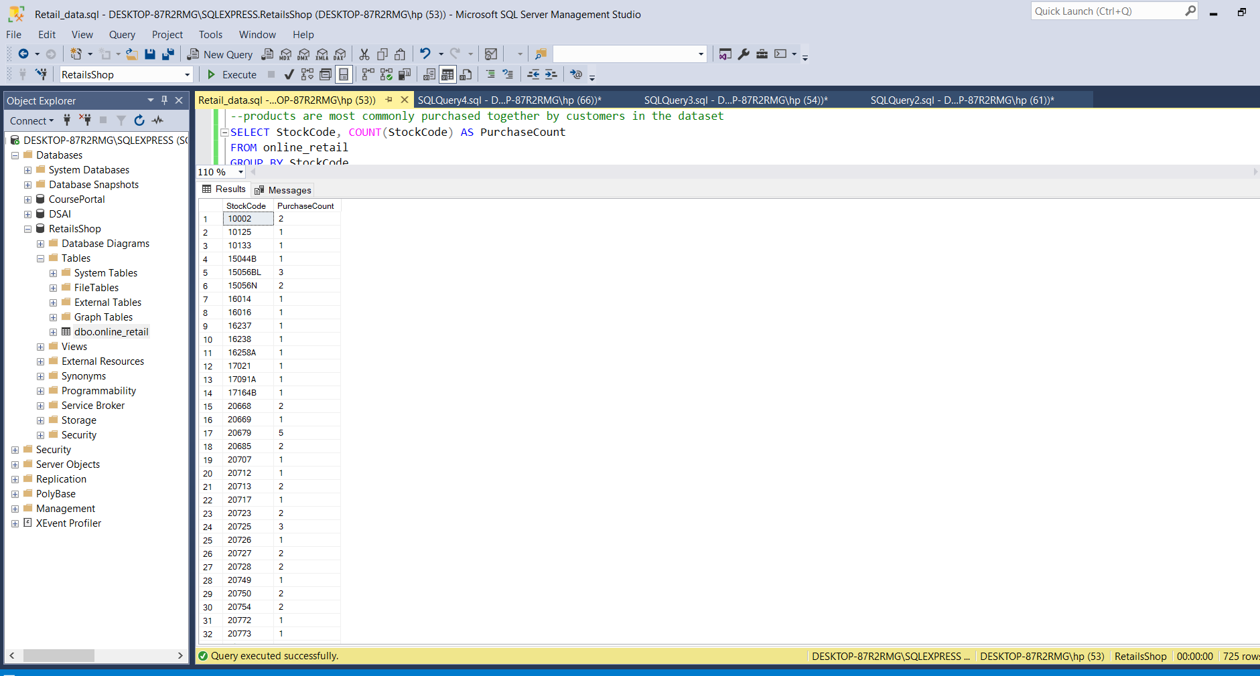
Most Commonly Purchased Products Together
Query Purpose: Discover which products are frequently bought together for potential cross-selling and bundling opportunities.
Key Findings: Some product combinations are consistently bought together, which presents an opportunity to create product bundles.

Slide 8
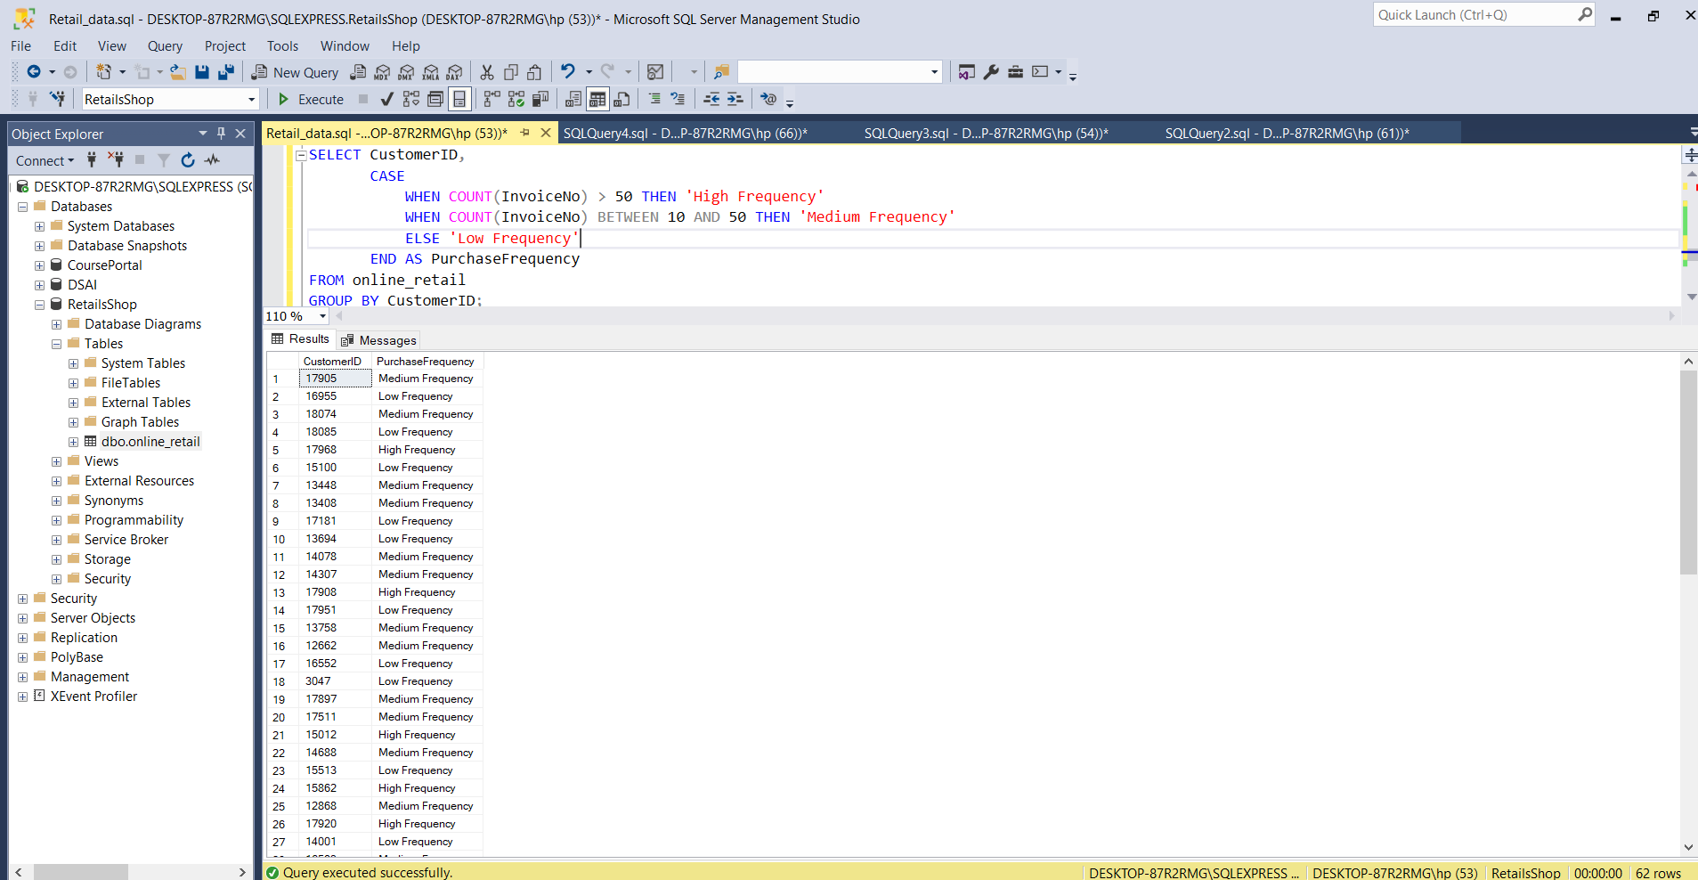
Customer Segmentation by Purchase Frequency
Query Purpose: Categorize customers based on purchase frequency (High, Medium, Low).
Key Findings: Few customers are high-frequency buyers, while many are medium or low-frequency customers.

Slide 9
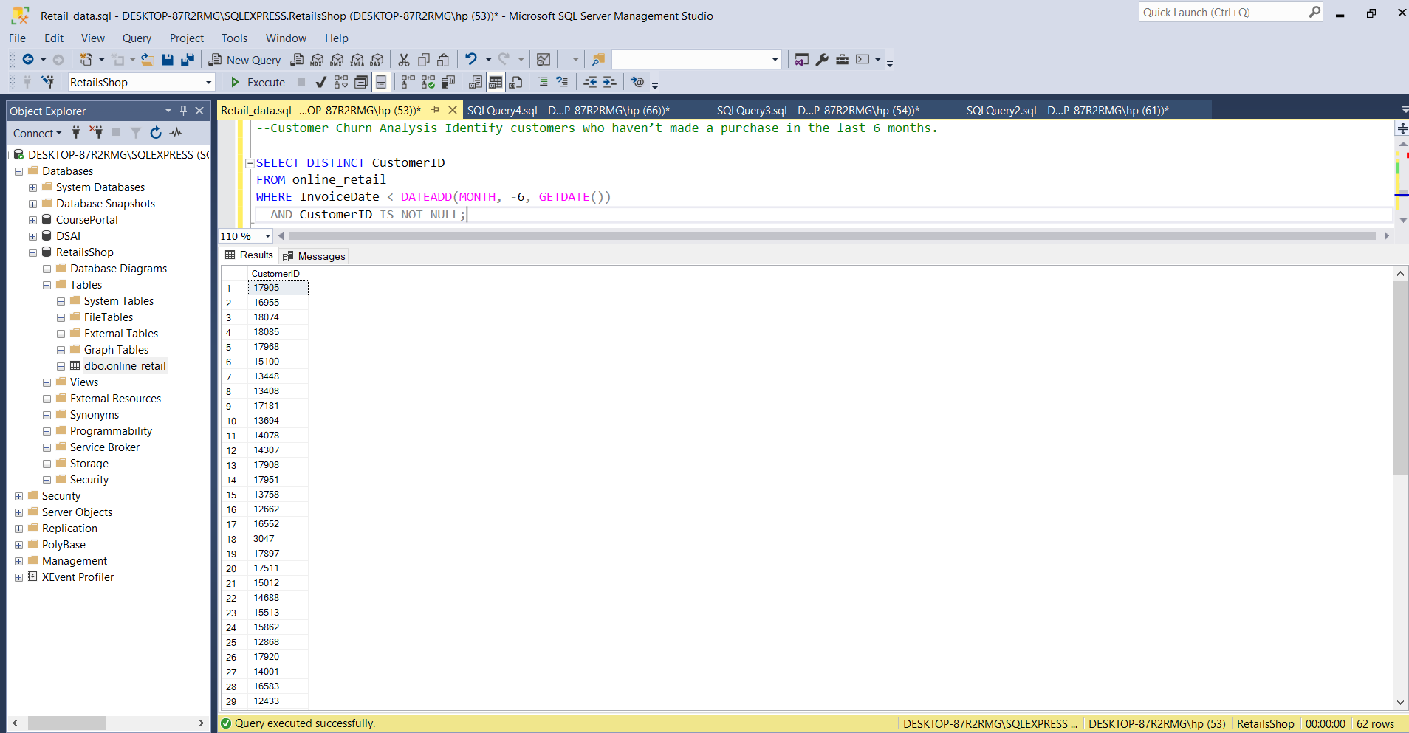
Customer Churn Analysis
Query Purpose: Identify customers who haven’t made a purchase in the last 6 months.
Key Findings: A significant number of customers haven’t made a recent purchase, indicating churn risk.

Slide 10
Conclusion
Summary of Findings:
High-value and high-frequency customers are critical to the business.
Single-purchase customers and customers at risk of churn present opportunities for growth and re-engagement.
Cross-selling and product bundling can boost revenue.

